Slide 1
4: British Social Attitudes

Slide 2
I have a long association with British Social Attitudes having used the data for teaching since its inception in 1983.
I had an even longer one with its co-founder, the late Prof Sir Roger Jowell, dating from the early 1970s when he and the late Gerald Hoinville left Research Services Ltd (RSL) to set up Social and Community Planning Research (SCPR: now Natcen)
Mark Abrams once told me, “Those two buggers took 12 of my best interviewers and set up on their own!”
Roger was a kindred spirit in professional standards and ethics in survey research and a much-valued and supportive colleague for over 30 years.
He died on Christmas Day 2011

Slide 3
Roger Jowell (1942-2011)

Slide 4
From the very beginning the British Social Attitudes survey has used mnemonic variable names in SPSS files. This is because the intention was to measure change over time and it was an administrative requirement to use the same variable name when questions were repeated in successive waves.
With limitations of 8-characters for names this made for some tortuous and bizarre names which are not easy immediately to relate to facsimile questionnaires, at least in earlier waves.
This convention, once adopted, was set in stone, as is the use of 0-10 scales in the European Social Survey, which Roger also co-founded in 2001. Both were the subject of many good-natured exchanges with him over the years.
I called it the “Juggernaut Syndrome”.

Slide 5
Teachers need ready-to-use files requiring little or no further preparation. Students may only have one semester of classes and lab sessions. Researchers need to factor in budgets, time, opportunity costs etc. All users need to be up and running with SPSS in the very first session. Criteria for ease of understanding and (immediate) use of SPSS files:
Full and clear documentation, including (facsimile) questionnaire
SPSS saved files well designed and easy to navigate
Names and/or variable labels easily linked to questionnaire
Variables in questionnaire order, not alphabetical order
Variable and value labels short but clear
Value labels to include question number, unless it is the variable name
Value labels in Mixed Case and literate
Missing values correctly and consistently assigned and declared
Measurement levels correctly assigned

Slide 6
British Social Attitudes
Question:
All in all, how satisfied or dissatisfied would you say you are with the way in which the National Health Service runs nowadays?
In all SPSS waves this variable is called nhssat

Slide 7
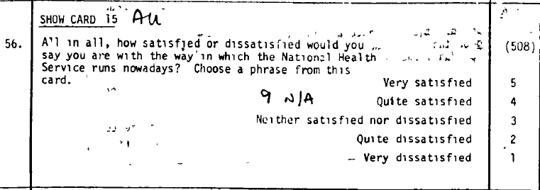
1983

Slide 8
1989

Slide 9
Data entered on 23 records per case
223090105007715248204 511201 112 110650201 1 61 01.0000
2230902119450011011 011322 1121121421 24111212112111131123342122 031 3743321
22309034 1001 22 2 42 090201123 122121331410206073
2230904 141151155 3
2230905
2230906
2230907 030914885344288282 212111 243324
223090804 07 11193207 3213224322
22309094 3 12 5 4 3 12 5 4 3 12 5 4 11 5 3 12 5 2 2 5
223091062 5 3 19 2 13111111 23666666252313923320108030531
2230911
2230912
2230913 13301 26 1423311131424 7
22309141041601258112292 2232 11
2230915 222 221 2 11 0708 035020906319108
2230916 000610331 11122203 055010906316404 00001012211 1
2230917 141021112 221920500655248190489 2
2230918244444224412211222114244442442299441444242442124881 212211
2230919
2230920 121221112122222111 44441111122312212
2230921 5555255255512412424 4444422414242444445
22309222113333332444244222233449442224 342234142
2230923 620048920660637011 0102443342321007332111

Slide 10
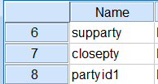
1983
Automatic processing has changed all names to lower case, but variable and value labels remain in UPPER CASE and question number appears at beginning of label.
However all missing values have been lost (None) and all levels are incorrectly set at Ordinal

Slide 11
2011
Q357 [NHSSat] *
CARD D1
All in all, how satisfied or dissatisfied would you say you are with the way in which the National Health Service runs nowadays?
Choose a phrase from this card

Slide 12
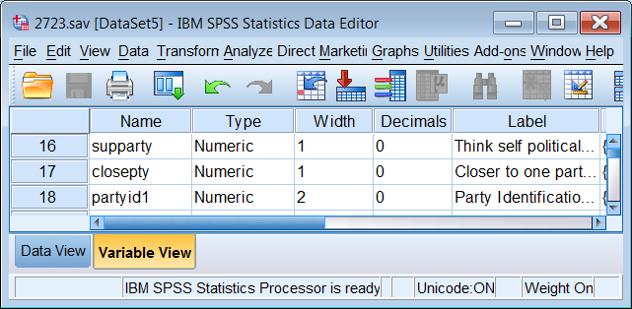
Mnemonic variable names are difficult to find in SPSS saved files, even if you know what the variables are called, eg nhssat which could be anywhere in the file:
Extract from 2011 saved file 2723.sav

Slide 13
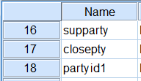
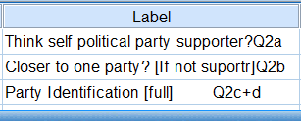
Labels are now in Mixed Case. Question numbers might help, but now they are all at the end of the labels!
. . and some of the the labels are very, very long!

Slide 14
British Social Attitudes 2011
Extract from 2011 saved file 7237.sav

Slide 15
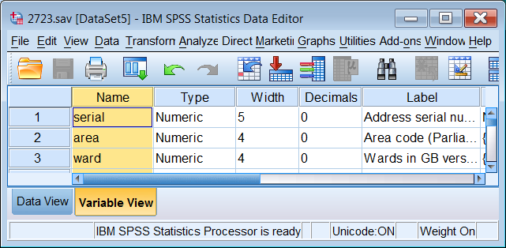
How do I find nhssat?
Click on Name to highlight the column

Slide 16
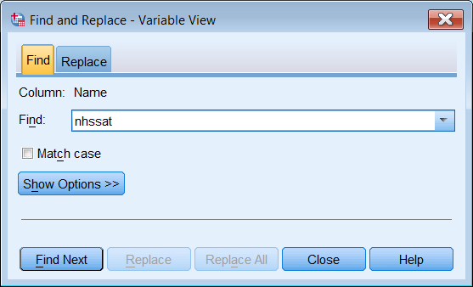
CTRL +F , then write in nhssat
Press Enter or Click

Slide 17
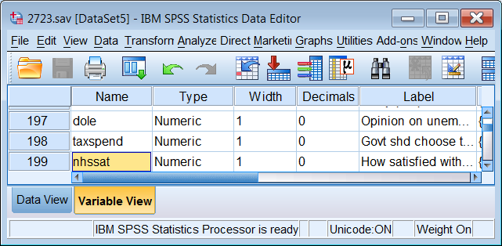

Slide 18
At SSRC and PNL, we devised a standard convention for all surveys in which variables were named after their position in the raw data file (751 below)
Q.72 data are entered on record 7 column 51: variable will be named v751
For teaching purposes, we renamed all the variables to their positional equivalents. With a printed copy of the questionnaire and the SPSS saved file open, this made it much easier for students (working from the saved file) to find the associated questions and vice-versa (working from the printed questionnaire) to find the associated variables.

Slide 19
CAPI, CATI and BLAISE put paid to that.
What now for navigation?
BSA 2011 was the first victim on my list.

Slide 20
British Social Attitudes 2011 (UKDS: SN 7237)

Slide 21
[Live link in here?]

Slide 22
British Social Attitudes 2011 User Guide Author: Roger Stafford
This is a well-designed interactive pdf file

Slide 23
2011
There is no printed questionnaire, only the CAPI file, but at least the question number and variable name are displayed.
(My colour highlights: Question [Variable name])
Q357 [NHSSat] *
CARD D1
All in all, how satisfied or dissatisfied would you say you are with the way in which the National Health Service runs nowadays?

Slide 24
British Social Attitudes 2011 Extract from distributed SPSS file bsa11.sav
Notes:
14 variables selected to represent different kinds of variable labels; drag Label margin out to see full labels.

Slide 25
Drag column separator to widen Label column
Scroll down to find longest label

Slide 26
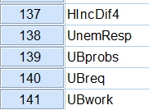
Mnemonic variable names
Question numbers all at the end
(and some labels start with lower case letters)
This causes problems when using dialog boxes

Slide 27
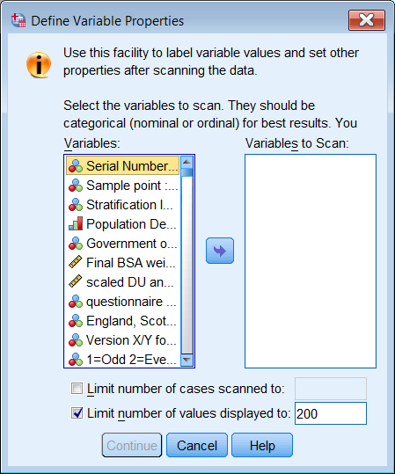
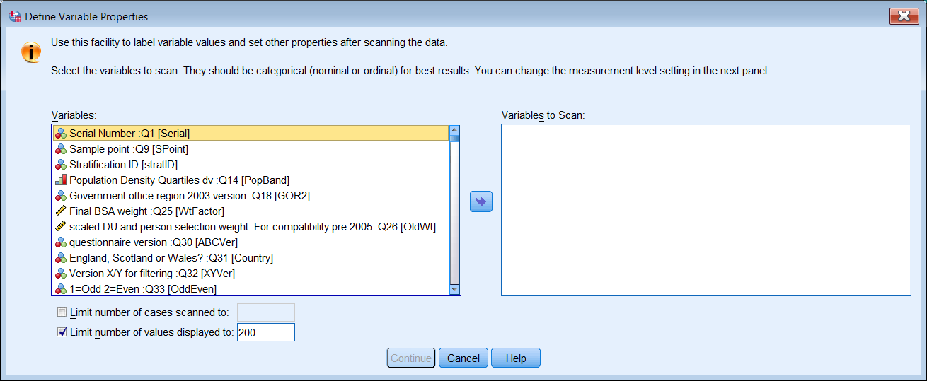
The question numbers are right at the end of the labels and you can’t see them without stretching the window

Slide 28
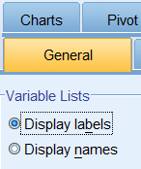
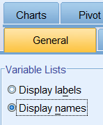
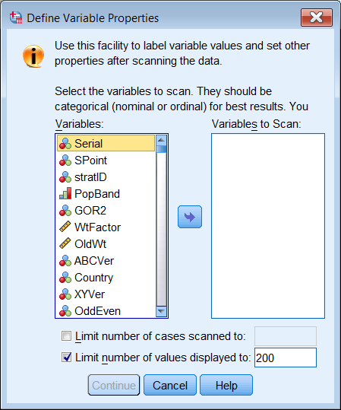
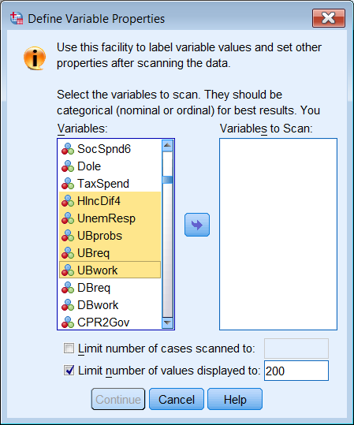
Change Labels to Names, but it takes
forever scrolling up and down to find the variables you want (even if you know what they are called!)

Slide 29
It would be much easier if the question numbers were moved to the beginning of the variable labels. This would be trivial for a few variables,
but . .
. . . there are 854 variables ! !
In answer to a request to the SPSS list for help (SPSSX-L@LISTSERV.UGA.EDU)

Slide 30
Enter Superman
a.k.a Jonathan “Kim” Peck
(Senior Software Engineer, IBM/SPSS) who in response to persistent tweak requests came up trumps with some amazing Python code. . .

Slide 31
Jon Peck’s Python code

Slide 32
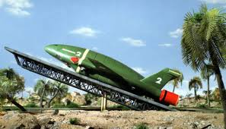
Thunderbirds are Go!

Slide 34
Initial Python code moved Q~~~ question numbers to beginning of label

Slide 35
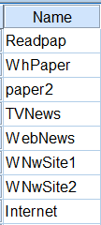
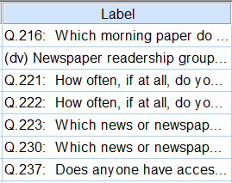
Question numbers moved to beginning of label

Slide 36
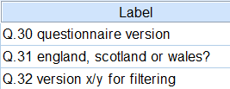
. . but all other upper case letters got changed to lower case:

Slide 37
There ensued much pestering of JKP by JFH “So far, so good. Question number has been moved to beginning of label and the colons have moved to after the question number, but. . .”
Upper case letters in labels were changed to lower case:
England, Scotland or Wales? :Q31
. . has changed to:
Q.31: england, scotland or wales?
Existing upper case initial letters need to be retained:
Q.31: England, Scotland or Wales?

Slide 38
Remaining problems
The first character after the question number needs to be in UPPER CASE, even if it was originally in lower case:
questionnaire version :Q30
Q.30 questionnaire version
Q.30 Questionnaire version
An improvement would be to insert a colon and a second space immediately after the question number.
Q.30: Questionnaire version
Q.31: England, Scotland or Wales?

Slide 39
After several more attempts JKP produced Python code which did more or less everything needed.
His code allowed for acronyms (BBC) and words and phrases with initial capital letters (Roman Catholic, Church of England, Jewish) to be embedded in the code and retained unchanged.

Slide 40
Derived variables
Where there is a freestanding dv or DV a neat solution would be to insert a # prefix to the question number and delete the dv or DV, again with colon and second space.
Q.58 person 2 relationship to respondent <7 categories> dv
# Q.58: Person 2 relationship to respondent <7 categories>
Weight in kilograms. dv a2.27b.
# Weight in kilograms. a2.27b.

Slide 41
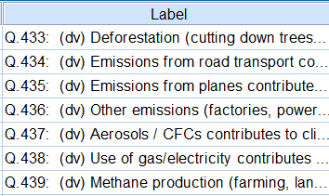
Derived variables

Slide 42
Same question, different question number
Where the question numbers are different depending on the questionnaire version administered, prefixing the label with a distinct symbol would be one solution, eg & :
The current benefit system is far too complicated a2.30cb2.1cc2.1c.
& The current benefit system is far too complicated a2.30cb2.1cc2.1c.

Slide 43
Same question, different question number
A2.30aB2.1aC2.1a.
A2.30bB2.1bC2.1b.

Slide 44
Same question, different question number
The current benefit system supports people in low-paid work A2.30aB2.1aC2.1a.
The current benefit system targets benefits only at those who really need them A2.30bB2.1bC2.1b.
The current benefit system is far too complicated A2.30cB2.1cC2.1c.
The current benefit system is slow to respond to changes in circumstances A2.30dB2.1dC2.1d.
The current benefit system effectively encourages recipients to move off benefits A2.30eB2.1eC2.1e.

Slide 45
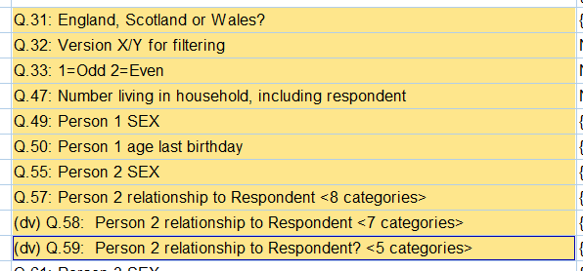
Despite looking cumbersome, all Q numbers were eventually moved to the beginning of the variable labels, preceded by (dv) if derived.

Slide 46
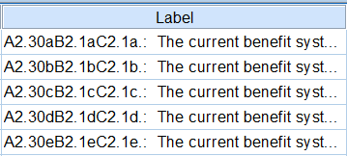
Same question, different question number

Slide 47
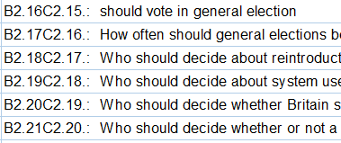
These sometimes took some finding as they didn’t all begin with A
There was even a stand-alone C

Slide 48
This also makes for easy visual scrolling in the Data Editor

Slide 49
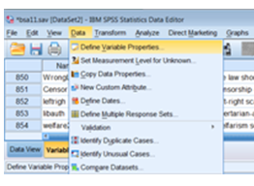
Q: Why do this? A: So you can see them in the dialog boxes

Slide 50
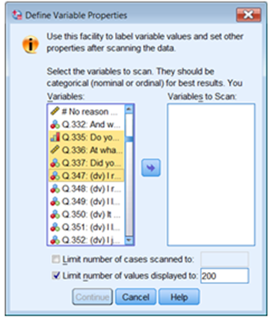
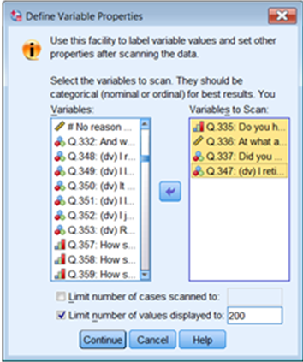
Highlight the variable(s) you want and click on
1: Opening window 2: Highlight variables 3: Transfer to right pane
Notes:
DVP is extremely useful when checking files as you can see the counts as well.

Slide 51
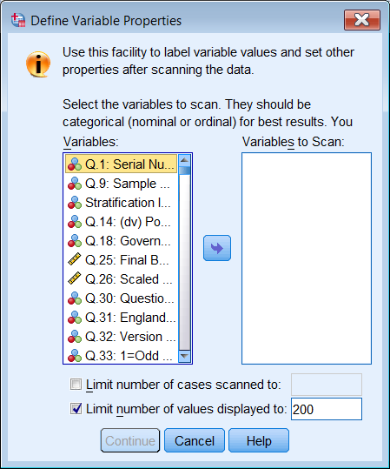
If you can’t see the text you can stretch the window:

Slide 52
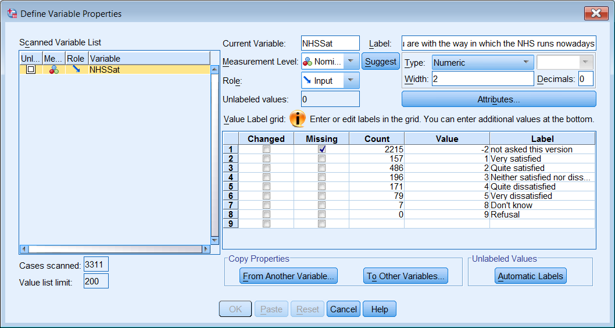
Display for Define Variable Properties (DVP) Variable NHSSat

Slide 53
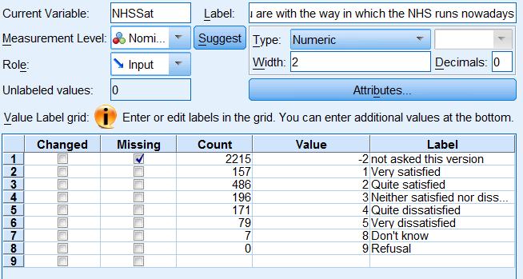
DVP is probably the most valuable facility for exploring SPSS files.
Indicates any values specified as Missing, displays number of cases under Count for each value encountered, together with Label (if any)

Slide 54
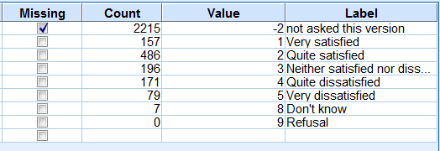
Missing values
Not all missing values have been declared, apart from negative values (and not always then).

Slide 55
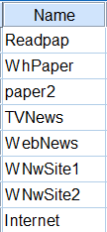
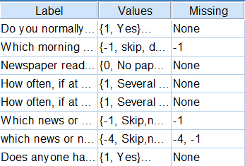
August 2013 version

Slide 56
Three missing values, none declared (Also two spurious decimal places in what should be integer values)
Notes:
Also two spurious decimal places added to what should be integer values

Slide 57
Missing values not declared
Whole swathes of values in the range 7, 97, 997, 9997 (Uncodable) 8, 98, 998, 9998 (Don’t know) and 9, 99, 999,9999 (Refusal) have not been so declared, even though they are explained in the user documentation.
SPSS only allows three discrete missing values to be entered, but In the examples below, for variables REarnQ and REarnD there are four values to be treated as missing.

Slide 58
Too many missing values
In many cases there are up to 5 values (and in one case 8) which can be, or need to be, treated as missing, but SPSS only allows for three discrete values.
As well as "Don't know", "Refused" some variables have codes for “Other” ”Uncodeable” “Can't decide” etc. which can/should be treated as missing?

Slide 59
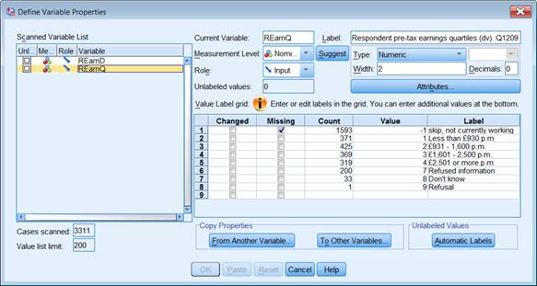
Four missing values: only one declared

Slide 60
Four missing values: only one declared
Notes:
My colour coding

Slide 61
Four missing values: only one declared
This is not a problem since two of the allowed values can be used to indicate the lower and upper limits of a range of values, eg:
missing values
rearnq (-1, 7 thru 9)
rearnd (-1, 97 thru 99) .
Notes:
Commands and variable names are case insensitive

Slide 62
Four missing values, only 2 declared
Notes:
Note lower case “s” in label for value 2

Slide 63
Five missing values, only three declared (1)

Slide 64
Five missing values, only three declared (2)
Notes:
Values not labelled, but 96 is 96 or older, 98 and 99 are missing.

Slide 65
Run frequency count to check frequencies esrjbtim .
Notes:
My colour coding

Slide 66
Solution for many missing values
One solution would be to recode all positive missing values to negative and declare missing values in the range (-99 thru -1)

Slide 67
1: Recode all positive missing values to negative

Slide 68
2: Specify new missing values

Slide 69
3: Write value labels for the new values using add value labels [NB: add needed, otherwise all other value labels will be lost]
Notes:
You need to use add value labels: if you use value labels, you will lose all the other value labels.
Note also the inconsistent labelling for the same values

Slide 70
4: Run frequency count to check
Notes:
My colour coding

Slide 71
In the Data Editor, when using negative missing values, value labels for the lowest value are displayed in the Values column. Up to three values, or the lower and upper limits of a range, are displayed in the Missing column

Slide 72
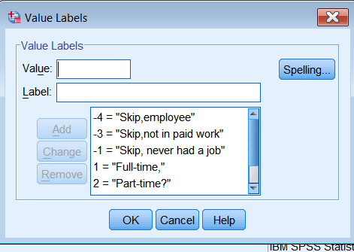
To see the non-missing labels for any variable click on a cell in the Values column then on the blue square

Slide 73
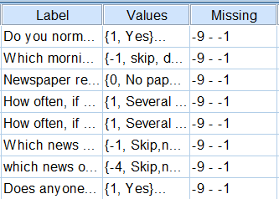
January 2014 version from UKDS has already been modified:

Slide 74
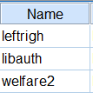
. . but these haven’t been changed:

Slide 75
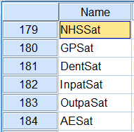
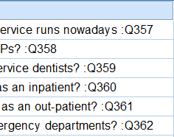
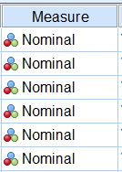
. . the question numbers are still at the end of the labels.
. . and the measurement levels have not yet been reset

Slide 76
See these *.sps files

Slide 77
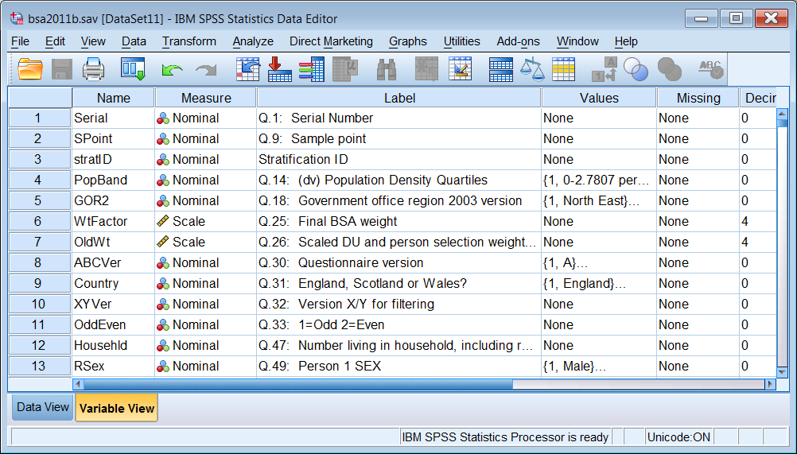
BSA 2011 now ready for teaching

