Slide 1
ASSESS 2014
Close Encounters of the Fourth Kind: working with alien SPSS files
Slides Title
(41) 1 Prologue
(29) 2 European Quality of Life Survey
(29) 3 Understanding Society
(77) 4 British Social Attitudes
(28) 5 Epilogue

Slide 2
ASSESS 2014
Close Encounters of the Fourth Kind: working with alien SPSS files
Prologue
John F Hall www.surveyresearch.weebly.com

Slide 3
Alternative title
Pig’s Sows’ Ears and Silk Purses: working with other people’s SPSS files

Slide 4
First, rewind 42 years to . .
Wed 26 July 1972
My first encounter with SPSS
SSRC Summer School in Survey Methods
St Edmund Hall, Oxford

Slide 5
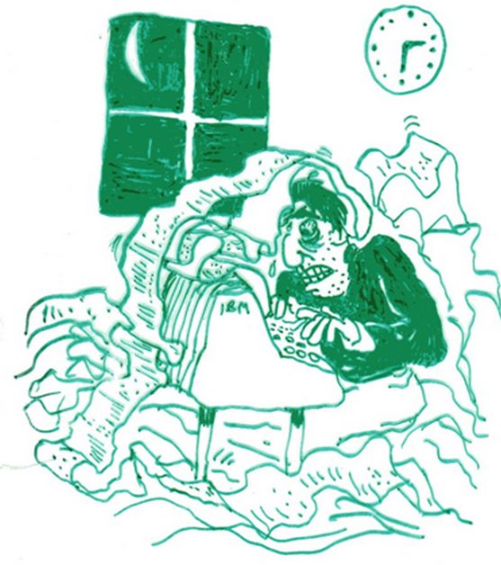
Scene: Oxford University Computer Centre
Date: Last night of course Time: 23:59

Slide 6

Right click on image above, then on Open hyperlink

Slide 7
Fast forward to 2001
Review of Julie Pallant
SPSS Survival Manual
(SRA News, Social Research Association, November 2002)

Slide 8
and my first encounter with:
(yes you guessed)
SPSS for Windows (Version 11) also with Windows, Word and PowerPoint for my review of:
Julie Pallant SPSS Survival Manual
(1st edition, Open University Press, 2001)
. . after which I was ready to kill (all mice)!

Slide 9
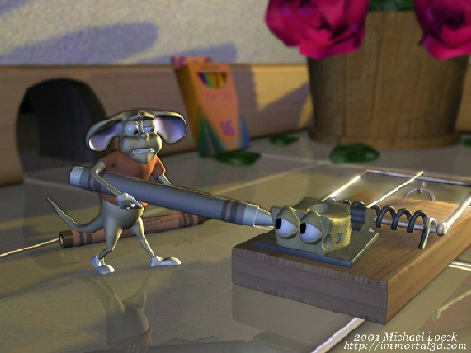
Right click on image above, then on Open hyperlink

Slide 10
Fast forward to ASSESS 2006
Old Dog, Old Tricks: Using SPSS syntax to avoid the mouse trap

Slide 11
Let battle commence!

Slide 12

In the blue corner

Slide 13
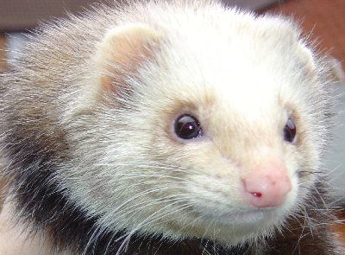
In the red corner:
(…and I just ♥ SPSS files)

Slide 14
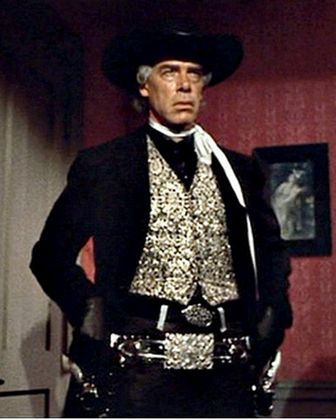
To the rescue!

Slide 15

..otherwise known as JFH
(…and they tell me I perform miracles)

Slide 16
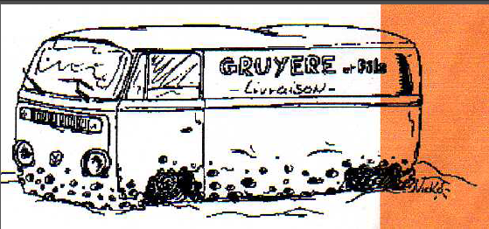
…by changing this
(or its equivalent SPSS file)

Slide 17
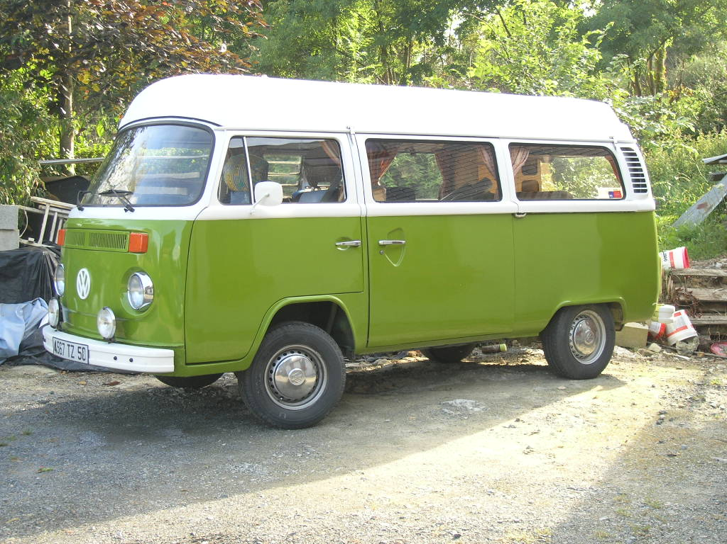
…to this (et voilà!)
(My Devon Moonraker, bought new in 1979, and still running:
restored bodywork, new 2-litre twin-carb engine, new exhaust, etc, but I digress . . )

Slide 18
Old Dog, Old Tricks
Advocated the use of syntax (thoughtful) in preference to point-and-click (mindless) because:
Syntax is far easier and quicker than the GUI, especially for basic operations
Syntax makes you think
Syntax leaves an audit trail
Demonstrated the above with detailed examples from Julie Pallant’s
SPSS Survival Manual (still unchanged in 4th edition 2010)

Slide 19
Old Dog, Old Tricks took me hundreds of hours over several months, but also got me in touch with colleagues from 20 years previously who had been instrumental in bringing SPSS to the UK and (like me) encouraging its use.
Tony Coxon first put Edinburgh University on to SPSS, and David Muxworthy, with Marjorie Barritt, installed it at Edinburgh in 1970, where it was reputedly called more times than the Fortran compiler.
Tony also set up the British Household Panel Survey in 1991 (UKDS: SN 5151) which from 2010 became Understanding Society.

Slide 20


They brought SPSS to Scotland
(still in the UK)
Tony Coxon
(1938-2012)
David Muxworthy
Even after 20 years, David said, “Of course I remember the Scarborough dynamo!”

Slide 21
Fast forward to
ASSESS 2014
Close Encounters of the Fourth Kind: working with alien SPSS files

Slide 22
I thought of using
Old Dog, New Tricks
Carries more bite, but is a bit of a misnomer.
Close Encounters is more a critical examination of SPSS files and documentation for major surveys, as distributed by UKDS and others for use in teaching or secondary analysis.
New tricks? Maybe.

Slide 23
Secondary use of SPSS files
Major surveys are well-financed and have large teams of researchers, authors and support staff.
Teachers, students and lone researchers wishing to use data from such surveys often have no resources other than their own time

Slide 24
Teachers need ready-to-use files requiring little or no further preparation. Students may only have one semester of classes and lab sessions. Researchers need to factor in budgets, time, opportunity costs etc.
All need to be up and running in the very first session.
Criteria for ease of understanding and (immediate) use of SPSS files:
Full and clear documentation, including (facsimile) questionnaire
SPSS saved files well designed and easy to navigate
Names and/or variable labels easily linked to questionnaire
Variables in questionnaire order, not alphabetical order
Variable and value labels short but clear
Value labels to include question number, unless it is the variable name
Value labels in Mixed Case and literate
Missing values correctly and consistently assigned and declared
Measurement levels correctly assigned

Slide 25
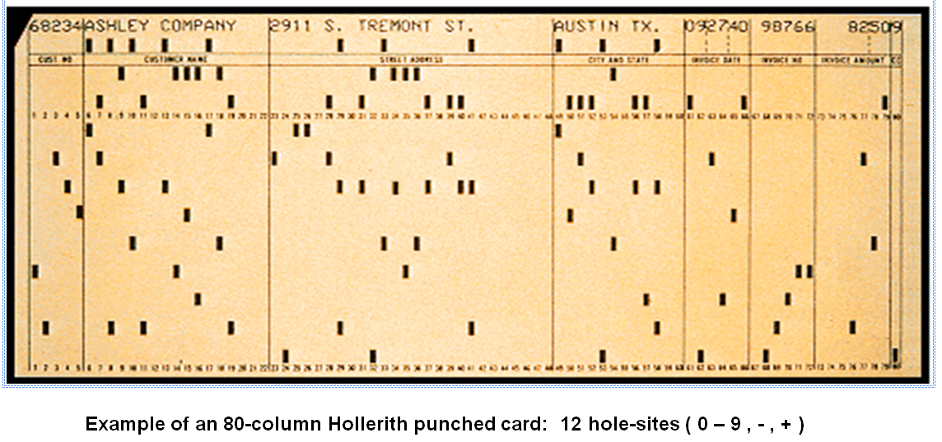
Data from many early surveys were punched on to 80-column Hollerith cards, one card per case: later copied or punched direct to card-image files.

Slide 26
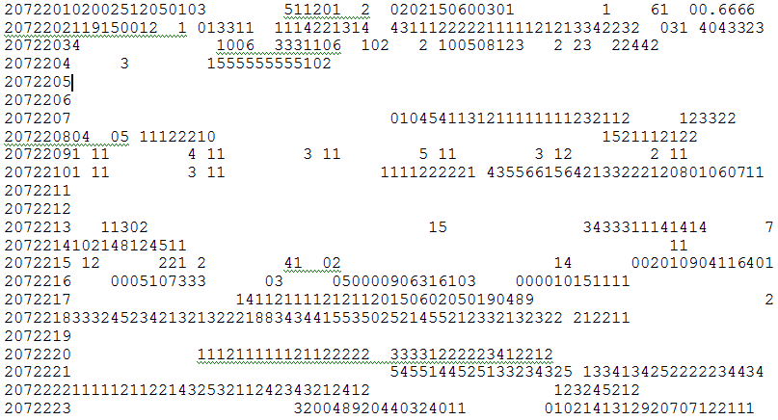
BSA 1989: Raw data for one case

Slide 27
Questionnaires varied as to their data coding and layout information

Slide 28
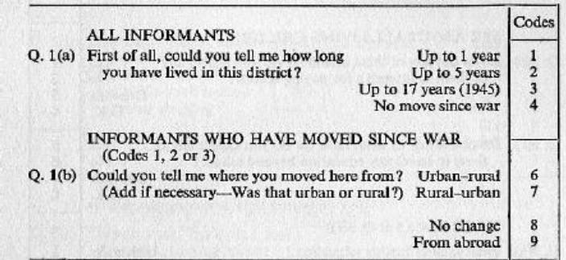
Relative Deprivation and Social Justice 1962
No data layout, also multi-punched

Slide 29
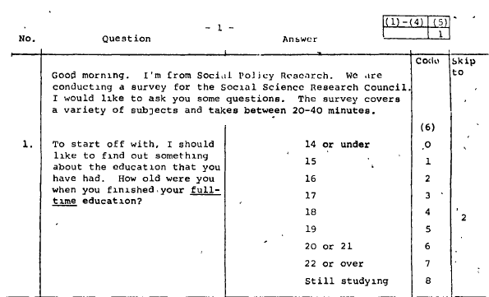
SSRC Multipurpose survey 1975

Slide 30
Fifth Form survey 1981
Q.34 (o) to Q.34 (r)
Data layout: record 2 cols 75-78, variables named v275 to v278

Slide 31
British Social Attitudes 1989
Data layout: record 15 cols 30-31
Variable name: v530

Slide 32
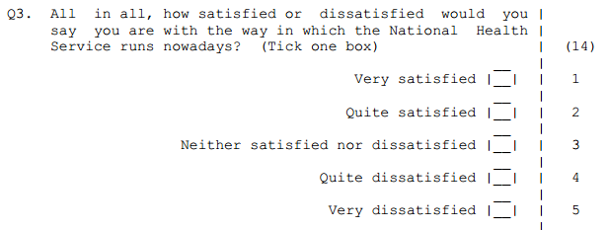
Pre-course questionnaire

Slide 33
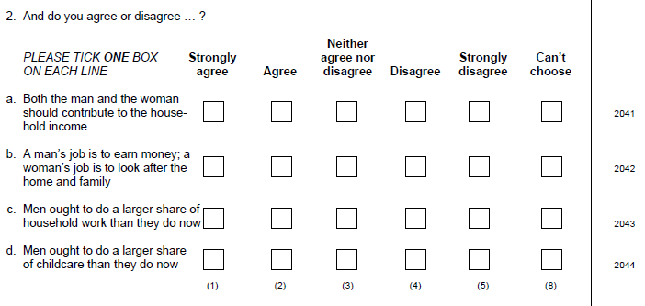
BRITISH SOCIAL ATTITUDES 2002
Data layout: record 20 cols 41-44

Slide 34
Many surveys use mnemonic variable names, but these can be difficult to find in SPSS files.
A convention developed in Peter Wakeford’s SDTAB program at LSE was to use the card and column number as a variable name (maximum 9 records per case)
At the SSRC Survey Unit this positional convention was adapted by John Hall and Jim Ring for use with SPSS and was employed for all unit surveys there and at the PNL Survey Research Unit. This made working with SPSS and the questionnaire together very simple.
All their questionnaires carried data layout information.
A similar system was adopted by SCPR/Natcen, but they retain the mnemonic convention.

Slide 35
Example: Pre-course questionnaire
(completed by students during queues for registration)
For Q.3 (Satisfaction with NHS)
(14) at top right indicates data to be single-punched in column (14)
One record per case: variable to be read in as v14

Slide 36

Q.5 (Sex) is to be single-punched in column (22)
Variable to be read in as v22
Column (25) is deliberately blank
Q.7 (Age last birthday) is punched as 2 digits in columns (26-27)
Variable to be read in as v26

Slide 37
Extract from raw data: one line (record) per case
NHS sex age metres feet inches
serial v14 v22 v26 v29 v34 v36
10 15324 323 4 3 2 1 22 5 3
11 24531 112 4 1235 2 1 39 1.68
12 25431 323 3 12 5 8
13 25413 2 3 3 2 4 1 1 28 5 10
14 42312 322 5 12 5 1 1 22 1.80
15 15324 213 4 23 2 1 36 5 1

Slide 38
This approach may seem incredibly simplistic, but I always found it a useful starting point for demonstrating to students where data come from in the first place
Older surveys used this format until the advent of CAPI, CATI and BLAISE enabled automated data capture direct to SPSS. However, if there is no text version, these latter can cause problems for users trying to analyse the data in conjunction with the questionnaire.

Slide 39
Data sets examined
European Quality of Life Survey 2007
Understanding Society 2010
ONS Opinions Survey, Well‐Being Modules 2011 (including unrestricted access data set for April 2011)
NORC General Social Survey (GSS) 2008
British Social Attitudes 2011
British Social Attitudes 2004
. . . plus a couple of surveys, one requiring partial, the other complete, restoration (and a very long memory)
SSRC Survey Unit Multi-purpose survey 1975
Relative Deprivation and Social Justice 1966*
* Survey 1962-63, book 1966, SPSS files 1975

Slide 40
Teachers need ready-to-use files requiring little or no further preparation. Students may only have one semester of classes and lab sessions. Researchers need to factor in budgets, time, opportunity costs etc.
All need to be up and running in the very first session.
Criteria for ease of understanding and (immediate) use of SPSS files:
Full and clear documentation, including (facsimile) questionnaire
SPSS saved files well designed and easy to navigate
Names and/or variable labels easily linked to questionnaire
Variables in questionnaire order, not alphabetical order
Variable and value labels short but clear
Value labels to include question number, unless it is the variable name
Value labels in Mixed Case and literate
Missing values correctly and consistently assigned and declared
Measurement levels correctly assigned

Slide 41
Constraints on course design and training materials
Timetable slots available
Staff knowledge and experience
Major data sets in public domain
Lecture room facilities
Computing facilities (terminals, printers)
Students (prior skill, motivation, affordability)
Typing and reprographics (need formatting so two pages fit on one side of A4, printed on both sides)

Slide 42
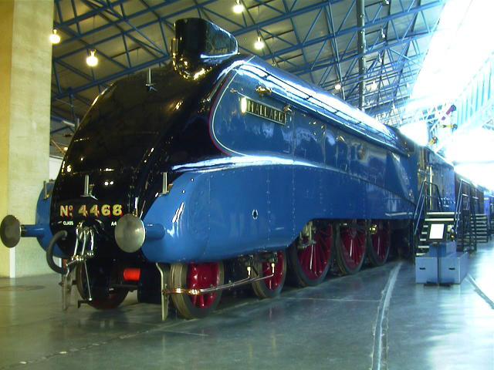
One side of A4
Gresley streamlined 4-6-2 Pacific class for LNER was known as class A4. This is Mallard at the National Railway Museum in York: it holds the world speed record for steam at 126mph (1931)
Notes:
Gresley streamlined 4-6-2 Pacific class for LNER was known as class A4. This is Mallard at the National Railway Museum in York: it holds the world speed record for steam at 126mph (1931)

